Slide 1
Context Based Pseudo Coloring
CSE 4128 : Image Processing and Computer Vision Laboratory
Presented by: Farhatun Shama Roll: 1907033 Semester:1st Year: 4th | Teachers: Dr. Sk. Mohammad Masudul Ahsan Professor Dipannita Biswas Lecturer
Department of Computer Science and Engineering
Khulna University of Engineering & Technology (KUET)
Date: 30/06/2024

Slide 2
Outlines
Objectives
Introduction
Tools used
Methodology
Limitations
Conclusion
Video Attachment

Slide 3
Objectives
To detect and match objects
To match histograms locally and globally
To obtain a simple colormap from an image
To color an input greyscale image according to a reference image

Slide 4
Introduction
Pseudo coloring or false color imaging assigns color values to grayscale images based on the intensity values
A feature vector is an n-dimensional vector that represents some object or attribute in an image
Object matching involves comparing feature vectors of objects to determine similarity

Slide 5
Tools Used
Python
OpenCV
Tkinter

Slide 6
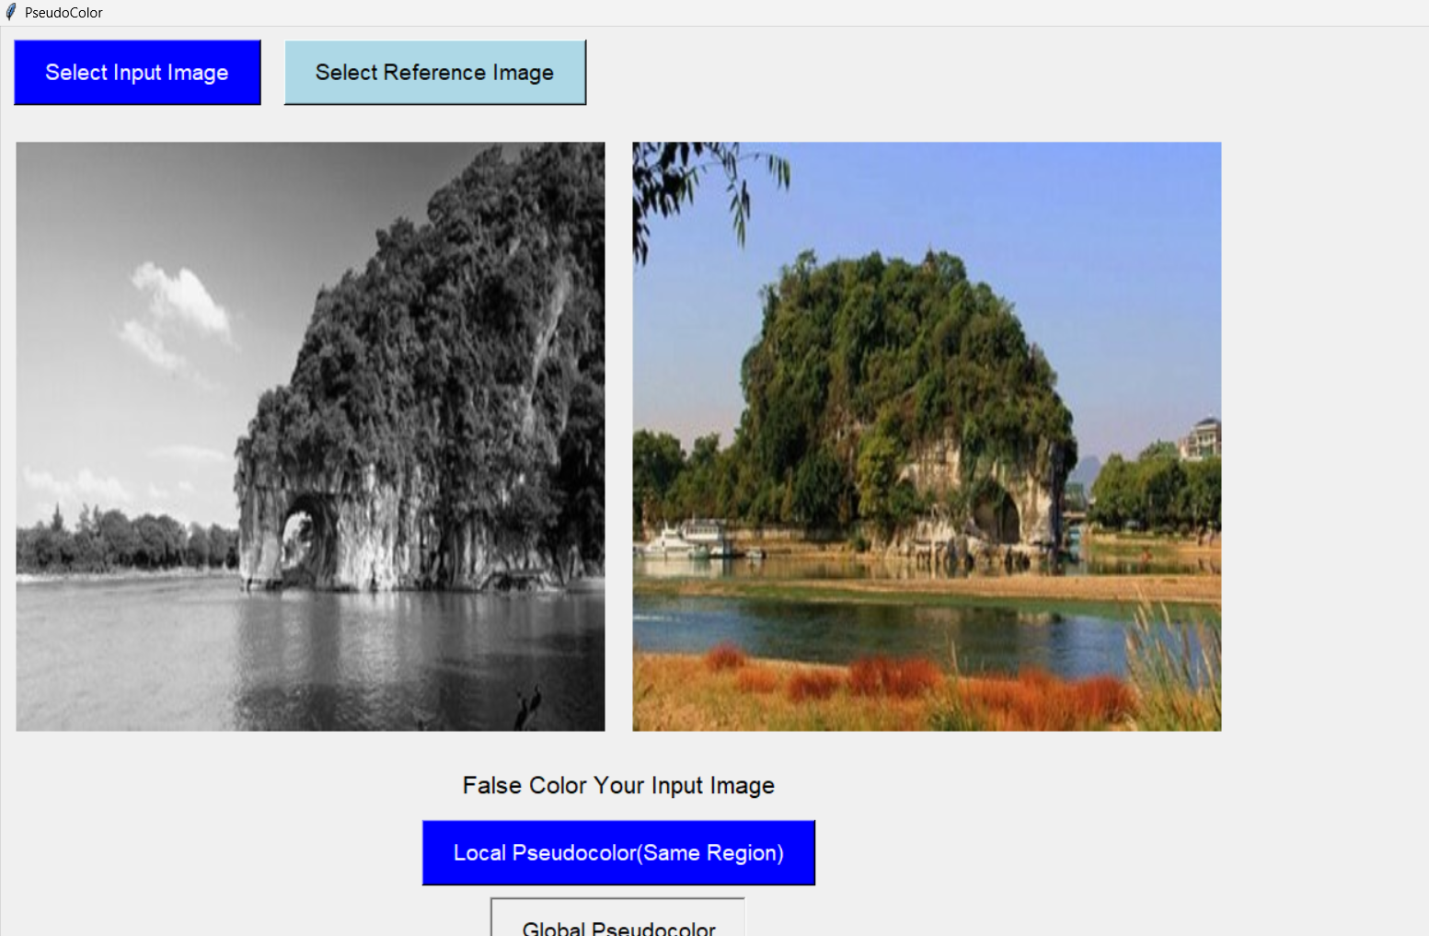
Methodology
A basic interface has been built using tkinter
Fig 1: Interface

Slide 7
Methodology (Cont’d…)
The input image can be false colored in 2 ways.
Global pseudo-coloring
Local pseudo-coloring
For Global pseudo-color, multiple techniques have been used.
Object based (scale variant and invariant features, haralick features)
Histogram based

Slide 8
Methodology (Cont’d…)
For object based global pseudo- color, first closing has been performed to fill holes
Contour is detected to find objects in both reference and input greyscale image
For each object, feature vector is calculated
Then each feature vector in input image is matched with all the feature vectors of reference image
Finally, the pair with minimum distance is identified as matched objects.

Slide 9
Methodology (Cont’d…)
The bounding rectangles for the matched pair are then calculated
Then a local colormap is obtained by mapping the reference grey patch and reference color patch
The input patch is colored according to this map in two ways-
In first output, the color values are put directly on input patch
In second output, the histogram of the input patch is matched to the reference patch histogram, then color values are added

Slide 10
Methodology (Cont’d…)
Global Histogram Matching
In global histogram matching, the input image histogram is directly matched to the reference greyscale histogram
A global colormap is obtained from the reference grey image and reference color image
The colormap is obtained by taking the mean R,G,B value for each greyscale intensity
Finally, the input greyscale image is colored according to this map

Slide 11
Methodology (Cont’d…)
Different types of features has been used for matching objects.
area, perimeter, roundness, form factor, compactness, axis_ratio, elongation, orientation, extent, solidity, eccentricity, ferret diameter,moments
2. Haralick features- energy, contrast, homogeneity

Slide 12
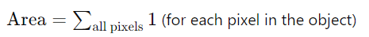
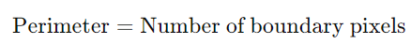
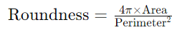
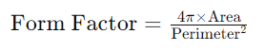
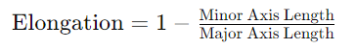
Methodology (Cont’d…)

Slide 13
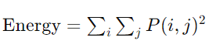
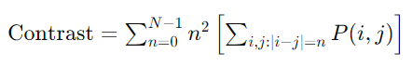
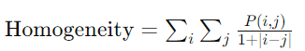
Methodology (Cont’d…)
Haralick features: (P(I,j) denotes the GLCM)

Slide 14
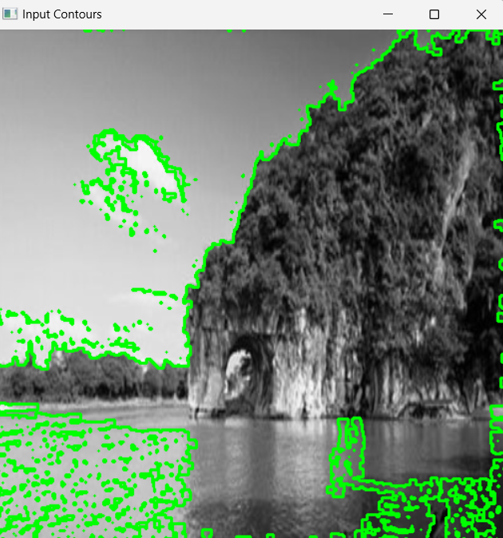
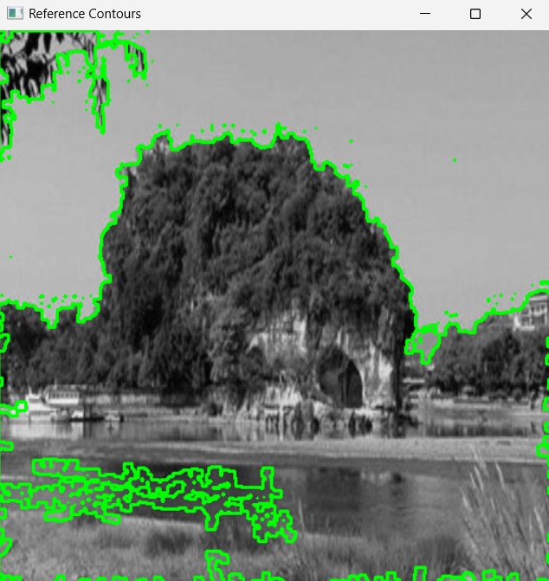
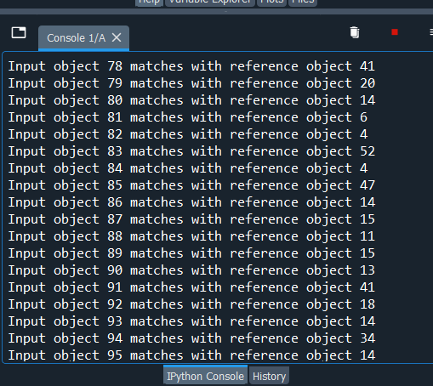
Methodology (Cont’d…)
Area, perimeter and moment-based matching
Input Contour
Reference Contour
Matching result snippet from console
Fig 2: Contours and Console results

Slide 15
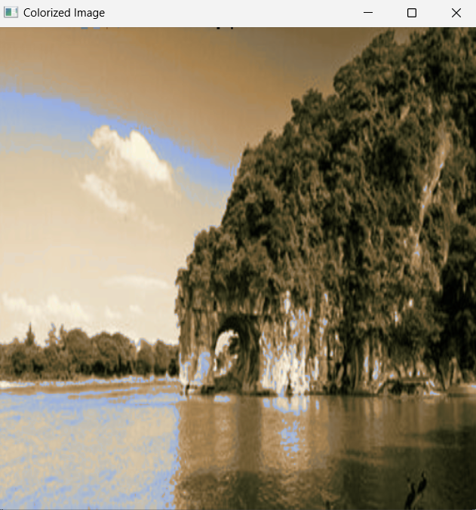
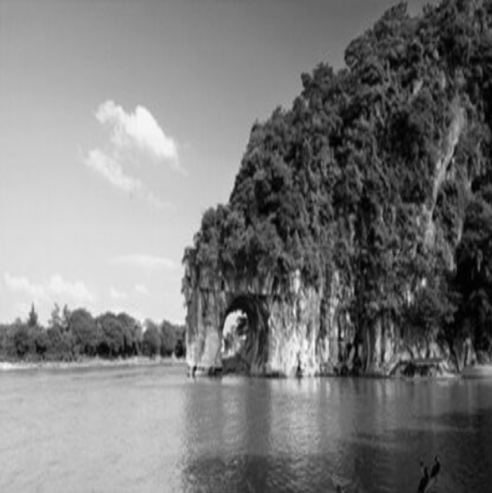
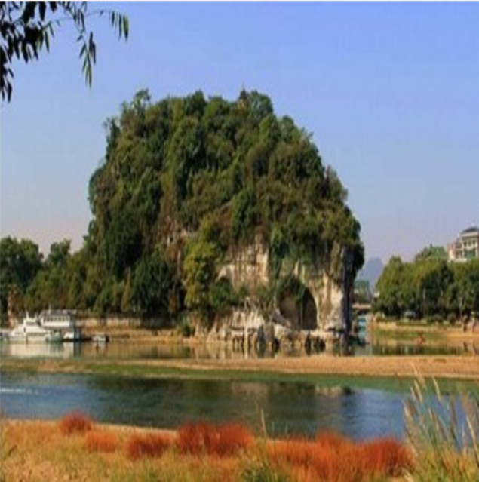
Methodology (Cont’d…)
Area, perimeter and moment-based matching
Input(greyscale)
Reference (Color)
Pseudo-colored image
Fig 3: Pseudo color using area. Moments etc

Slide 16
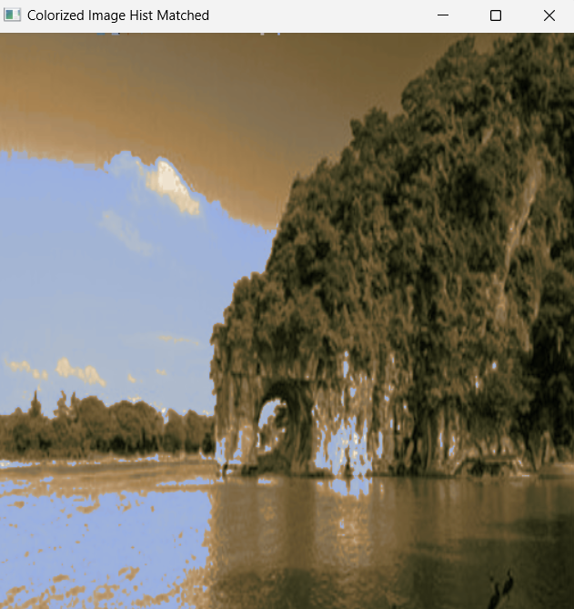
Methodology (Cont’d…)
Area, perimeter and moment-based matching with object histogram
Input(greyscale)
Reference (Color)
Pseudo-colored image
Fig 4: Pseudo color (object histogram)

Slide 17
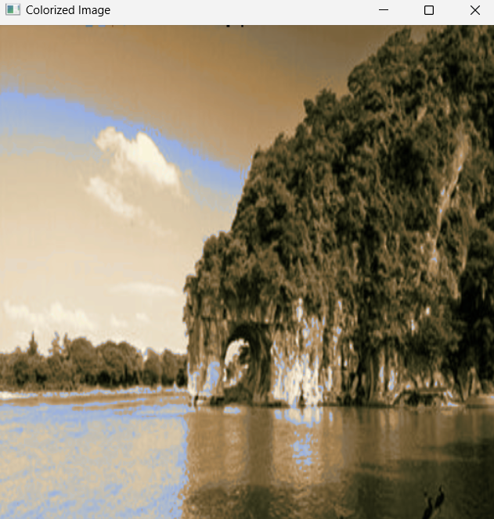
Methodology (Cont’d…)
Haralick feature based matching
Input(greyscale)
Reference (Color)
Pseudo-colored image
Fig 5: Pseudo color (Haralick Feature)

Slide 18
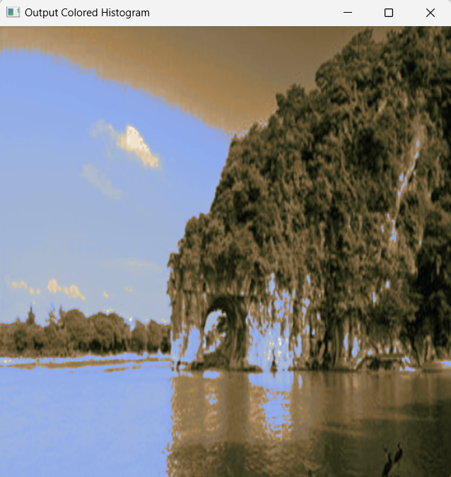
Methodology (Cont’d…)
Histogram matching (Global)
Input(greyscale)
Reference (Color)
Pseudo-colored image
Fig 6: Pseudo color using global histogram

Slide 19


Methodology (Cont’d…)
Comparative outputs
Feature Matching
Object histogram Matching
Global Histogram Matching
Fig 7: Outputs Comparison

Slide 20

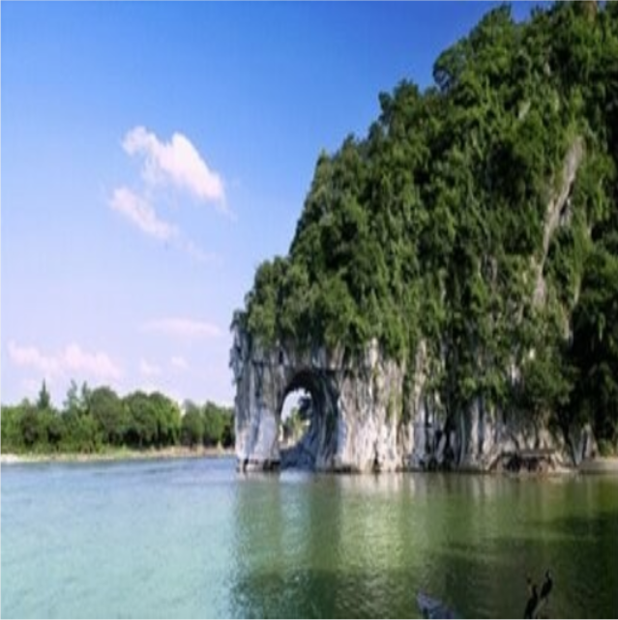
Methodology (Cont’d…)
Input pseudo colored image vs input real colored image
feature Matching
Global Histogram Matching
Real Colored Input
Fig 8: Outputs vs original color input

Slide 21
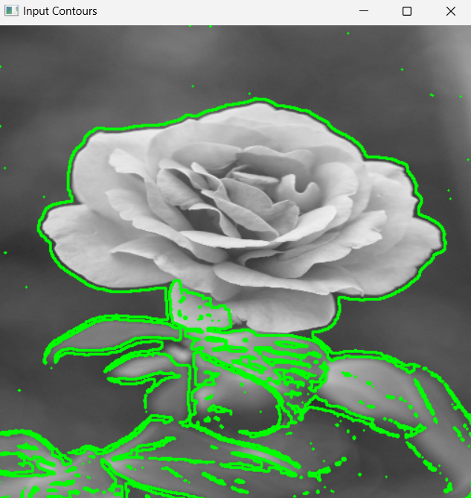
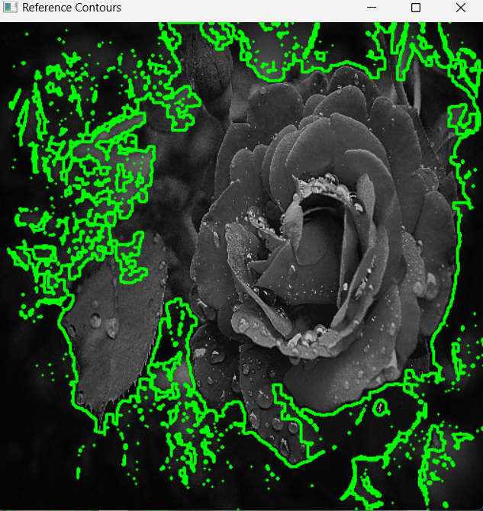
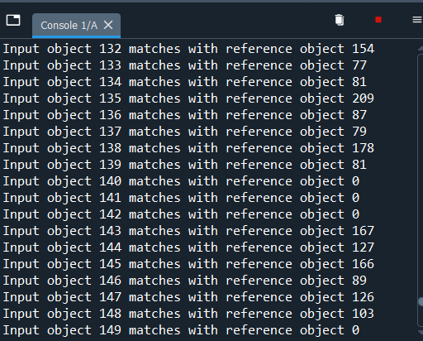
Methodology (Cont’d…)
Area, perimeter and moment-based matching
Input Contour
Reference Contour
Matching result snippet from console
Fig 9: Contours and Console output

Slide 22
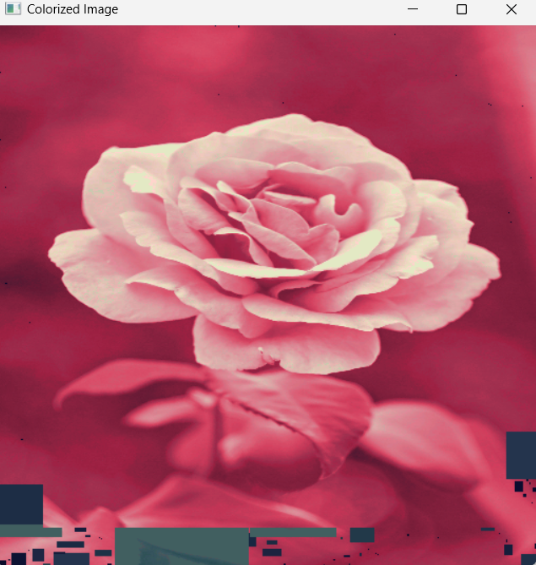
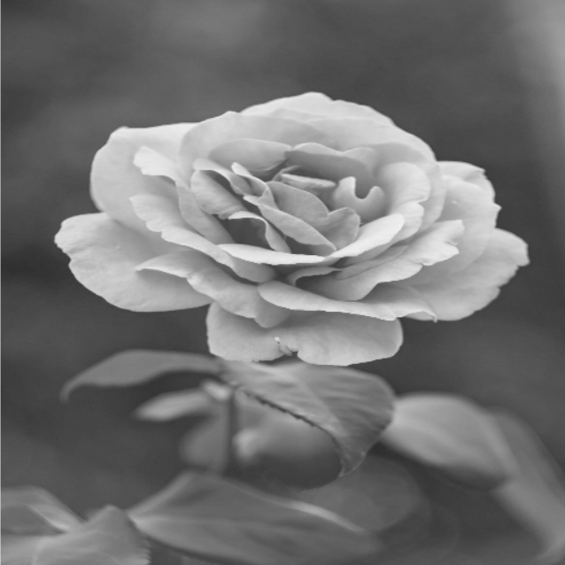
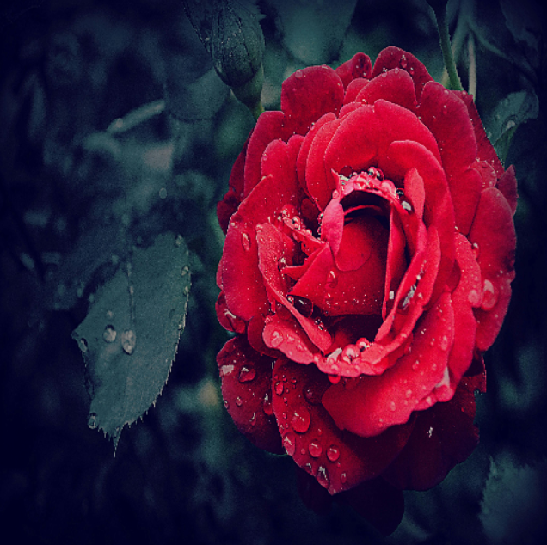
Methodology (Cont’d…)
Area, perimeter and moment-based matching
Input(greyscale)
Reference (Color)
Pseudo-colored image
Fig 10: Pseudo color using area. Moments etc

Slide 23
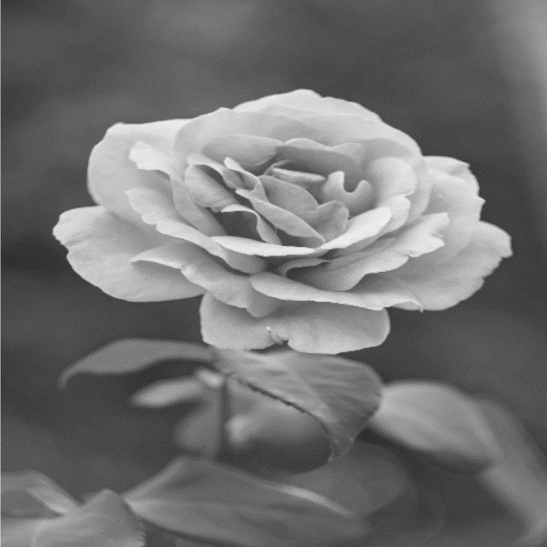
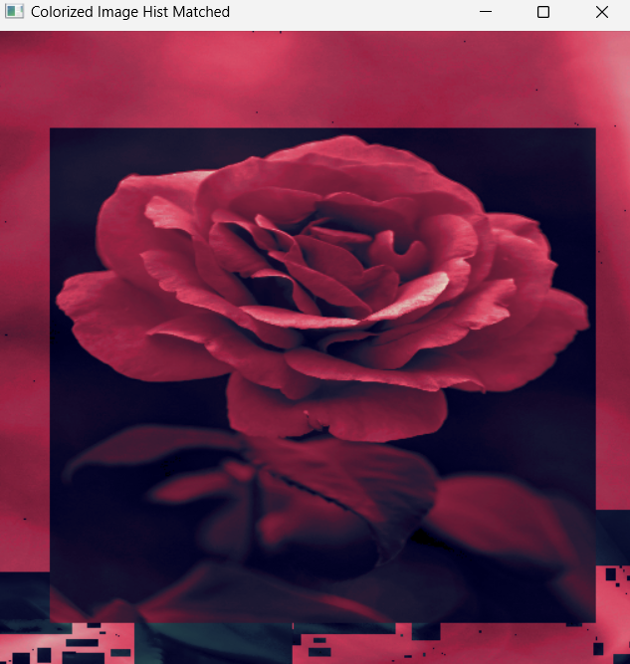
Methodology (Cont’d…)
Area, perimeter and moment-based matching ( object histogram)
Input(greyscale)
Reference
Pseudo-colored image
Fig 11: Pseudo color using object histogram

Slide 24
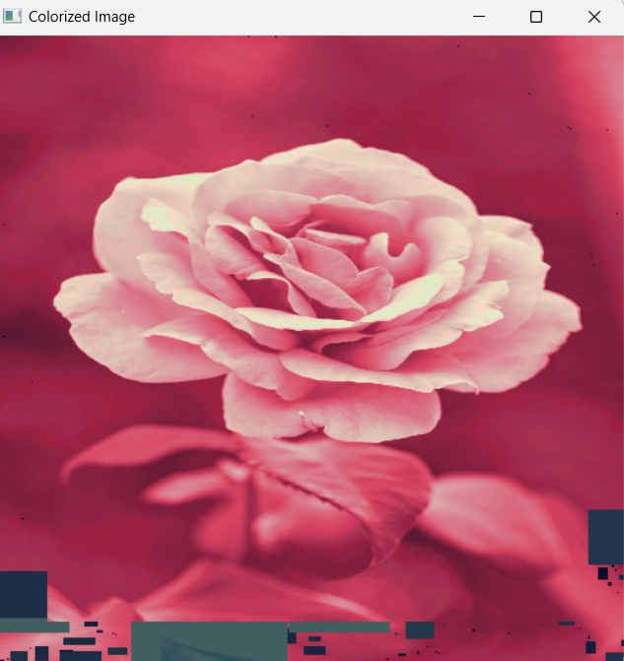
Methodology (Cont’d…)
Haralick feature based matching
Input(greyscale)
Reference
Pseudo-colored image
Fig 12: Pseudo color using Haralick feature

Slide 25
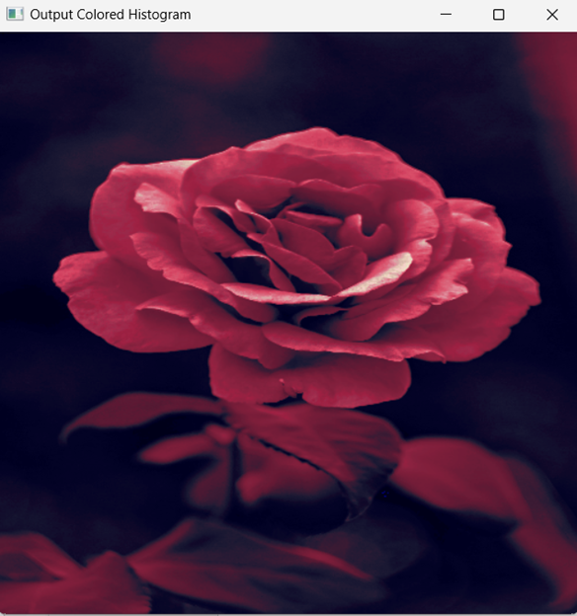
Methodology (Cont’d…)
Global Histogram
Input(greyscale)
Reference
Pseudo-colored image
Fig 13: Pseudo color using global histogram

Slide 26

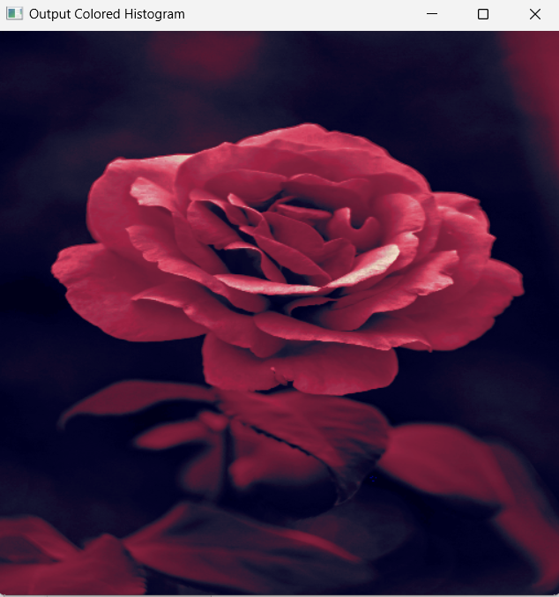
Methodology (Cont’d…)
Comparative outputs
Moment and other feature Matching
Haralick feature Matching
Global Histogram Matching
Fig 14: Output Comparison

Slide 27
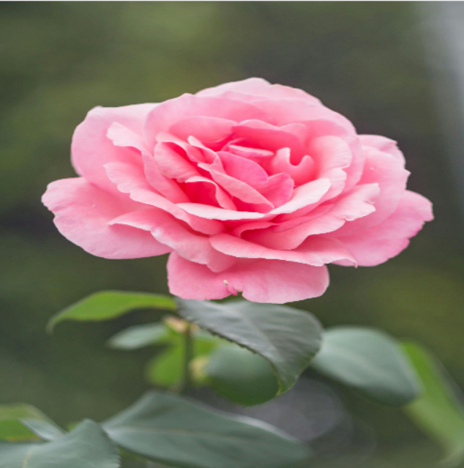
Methodology (Cont’d…)
Input pseudo colored image vs input real colored image
Feature Matching
Global Histogram Matching
Real Input
Fig 15: Output vs real input

Slide 28
Methodology (Cont’d…)
Local Region Coloring
In the local region coloring , the user selects a region of interest from the reference image and input image
The indices of the ROI of reference grey and reference colored image are then used to obtain a colormap
Then the input ROI is traversed, and color is put according to the obtained colormap
Histogram matching of input ROI and output ROI is also done

Slide 29
Methodology (Cont’d…)
The pixels inside region of interest are marked as 1 and the rest are marked 0
For coloring only these ‘1’ marked pixels are colored. The rest remain black.

Slide 30
Methodology (Cont’d…)
Input and Reference Image
Input(greyscale)
Reference (Color)
Fig 16: Input and reference Image

Slide 31
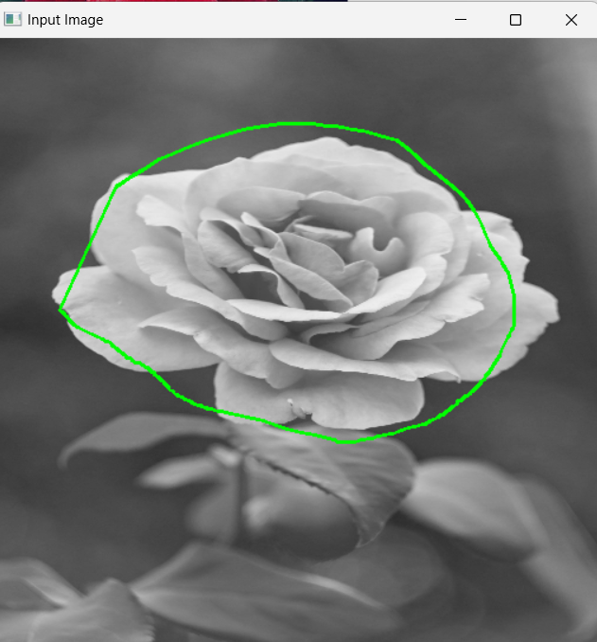
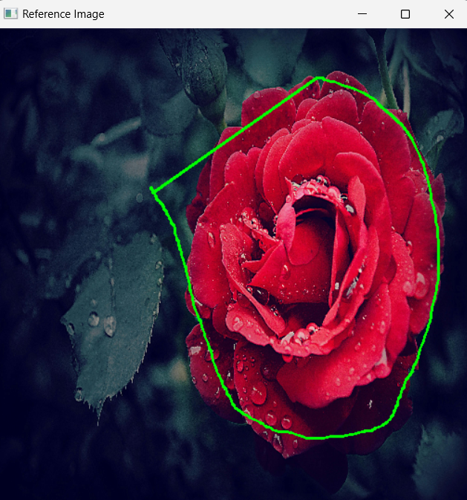
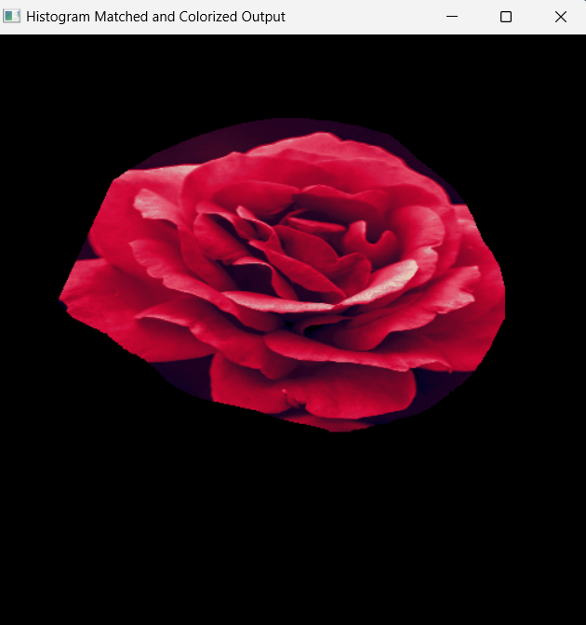
Methodology (Cont’d…)
Region of Interest (ROI) and Output
Input ROI
Reference ROI
Output
Fig 17: ROI Selection and output

Slide 32
Limitations
The features used for object matching are unable to correctly match objects in some cases
The haralick feature calculation take a lot of time, making the output generation process significantly slower
In case of different orientation of same object, the reference orientation was not altered to match the input
For this reason, avg local colormap was used instead of exact color copying

Slide 33
Conclusion
Pseudo coloring enhances visual representation of greyscale images
For object matching, there are several challenges. If all the features used for matching are scale invariant, then a large object can match to a very small object
Morphological closing operation can fill gaps which are smaller than structuring element. In this case this helped greatly for removing too small objects

Slide 34
Conclusion (Cont’d…)
The features used were able to match some of the same objects with different orientation, but not all
Haralick features take a long time for computation, In this case, they did not enhance the output significantly

Slide 35
Thank You

